Slide 1

Digital Twin
Notes:
Westmann

Slide 2

Introduction
Notes:
Westmann

Slide 3

Exploring the data
Notes:
Westmann

Slide 4

Exploring the data
Choosing time interval
3 days with consistent data
train = df_scaled.loc["2023-01-27":"2023-01-30"]
test = df_scaled.loc["2023-02-27":"2023-03-02"]
Notes:
Westmann

Slide 5
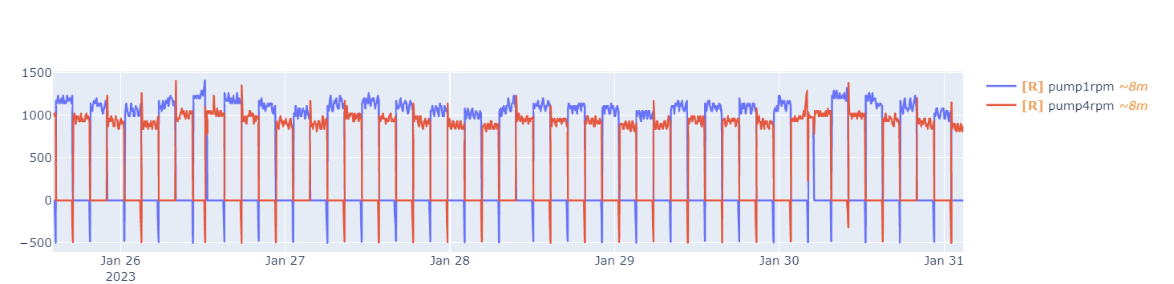
Exploring the data
Notes:
Westmann

Slide 6
Exploring the data
Resampling
Resampling using the mean values for every minute.
pump_station_data.resample("1T").mean()
Notes:
Westmann

Slide 7

Static Model
Parameter Estimation by Regression
Notes:
Emil

Slide 8

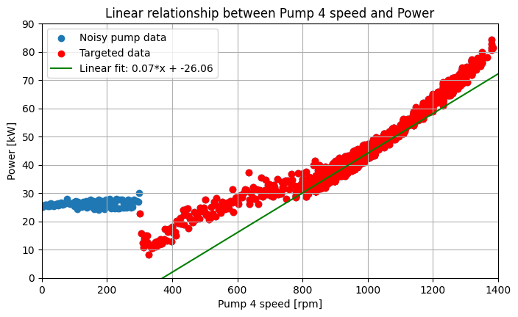
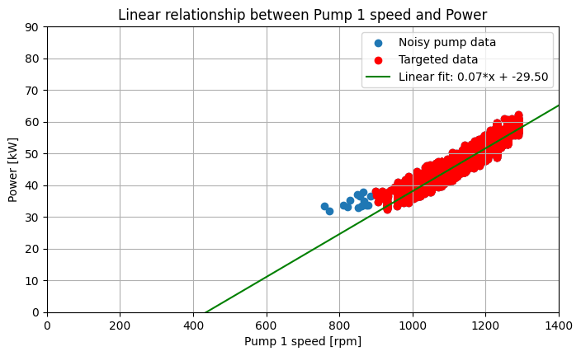
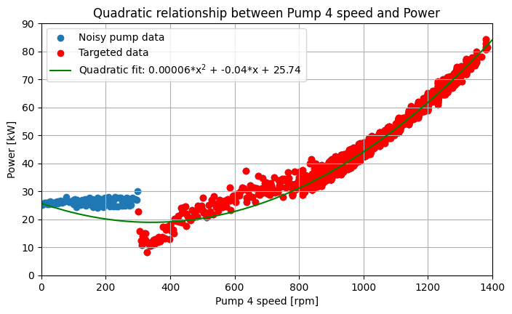
Power over speed
MSE | 1.38
RMSE | 1.17
MAE | 0.95
RRSE | 0.26
MSE | 1.14
RMSE | 1.07
MAE | 0.77
RRSE | 0.27
MSE | 0.82
RMSE | 0.91
MAE | 0.72
RRSE | 0.23
Notes:
Emil

Slide 9
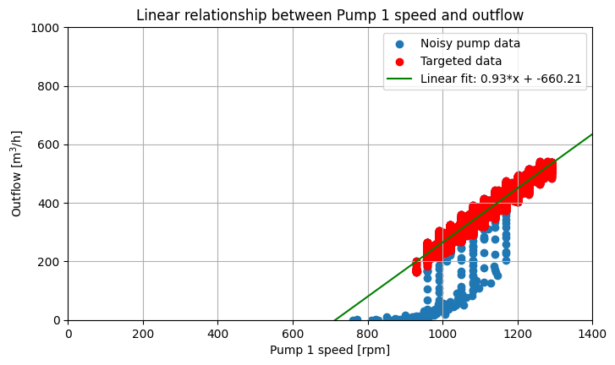
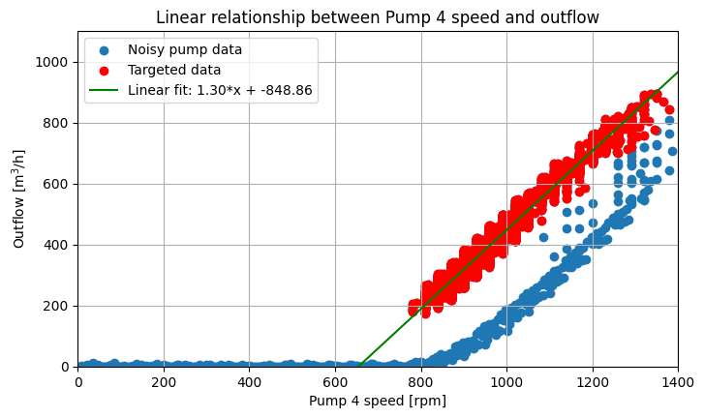
Outflow over speed
MSE | 128.58
RMSE | 11.34
MAE | 8.60
RRSE | 0.19
MSE | 260.89
RMSE | 16.15
MAE | 11.90
RRSE | 0.23
Notes:
Emil

Slide 10
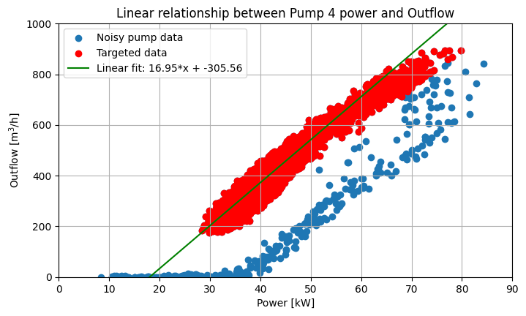
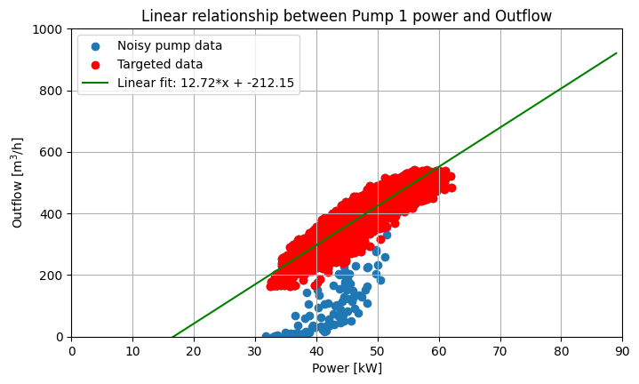
Outflow over Power
MSE | 546.54
RMSE | 23.38
MAE | 18.44
RRSE | 0.34
MSE | 370.42
RMSE | 19.25
MAE | 15.25
RRSE | 0.32
Notes:
Emil

Slide 11

Dynamic Model
Notes:
Christian

Slide 12
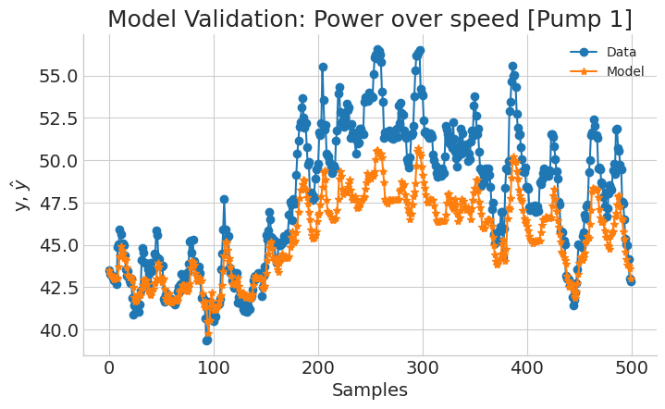
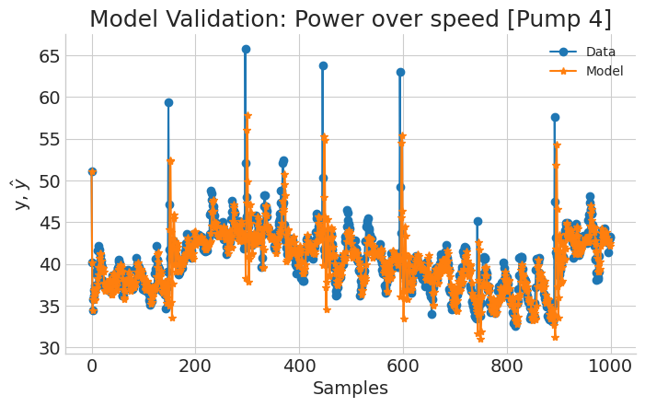
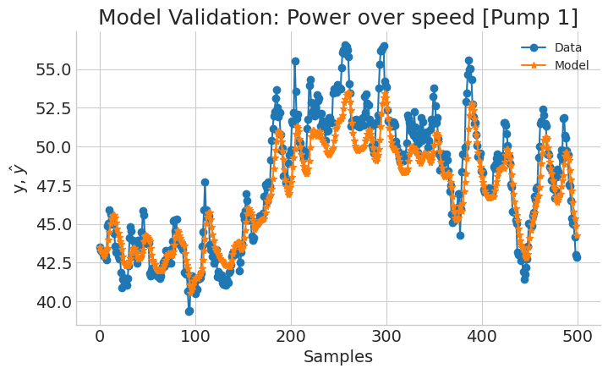
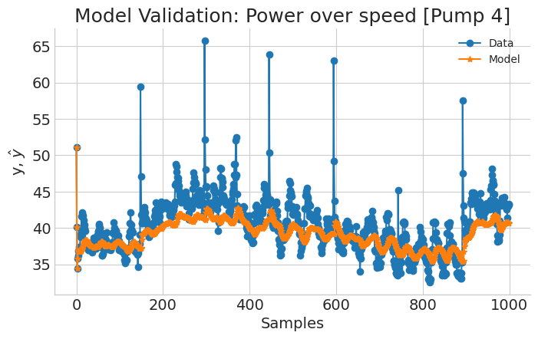
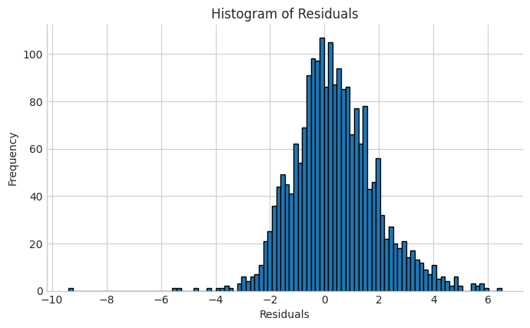
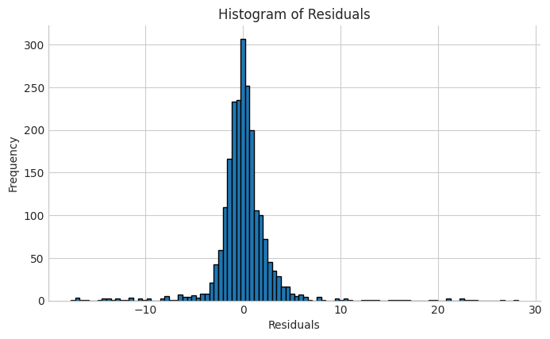
Power over speed
Degree = 1
N-info-values = 7
xlag = 6
ylag = 7
estimator = least_squares
Degree = 1
N-info-values = 8
xlag = 5
ylag = 5
estimator = least_squares
MAE = 1.20
MSE = 2.47
RMSE = 1.57
RRSE = 0.37
MAE = 1.64
MSE = 9.23
RMSE = 3.04
RRSE = 0.82
Notes:
Christian

Slide 13
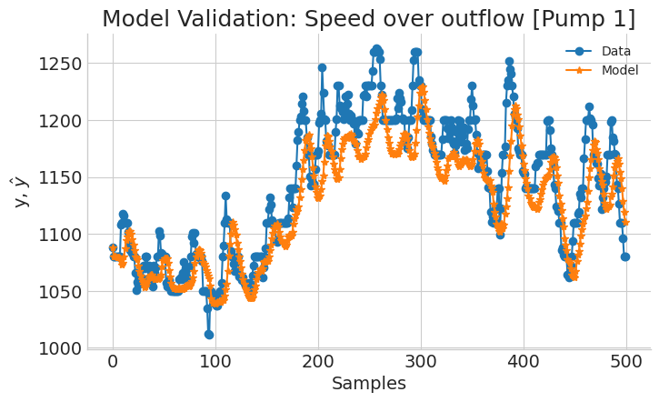
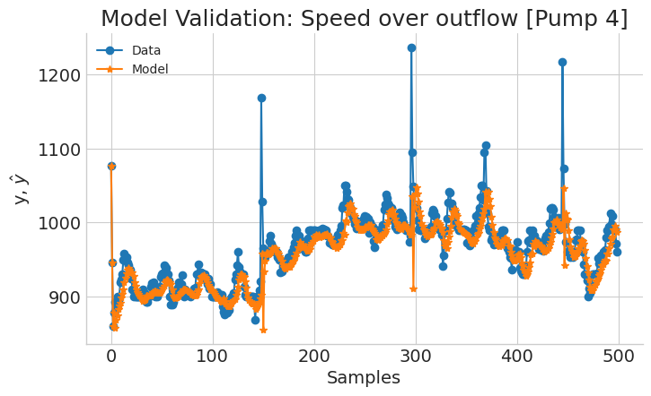
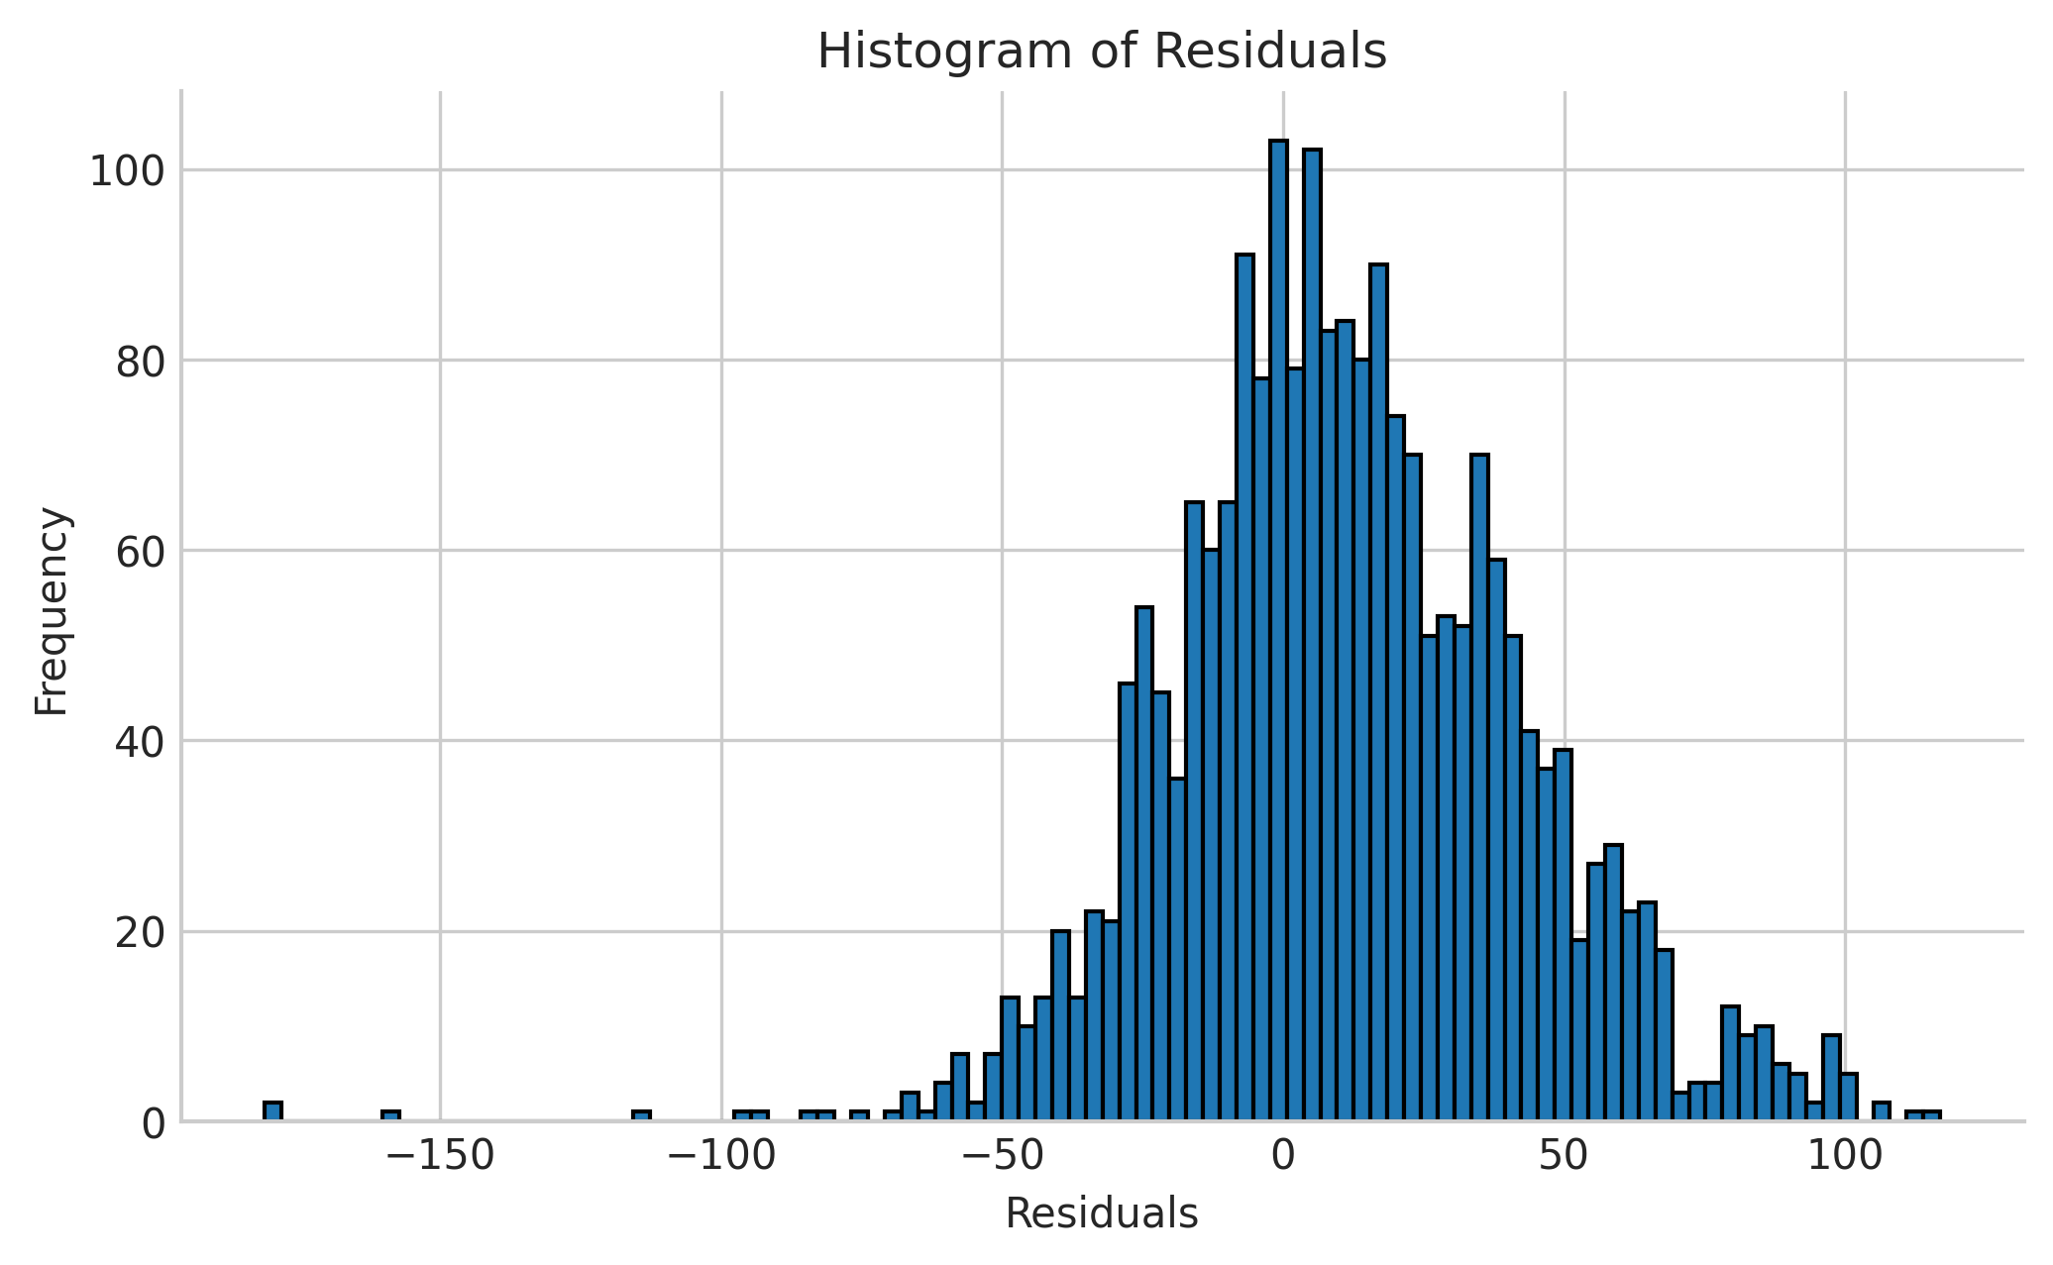
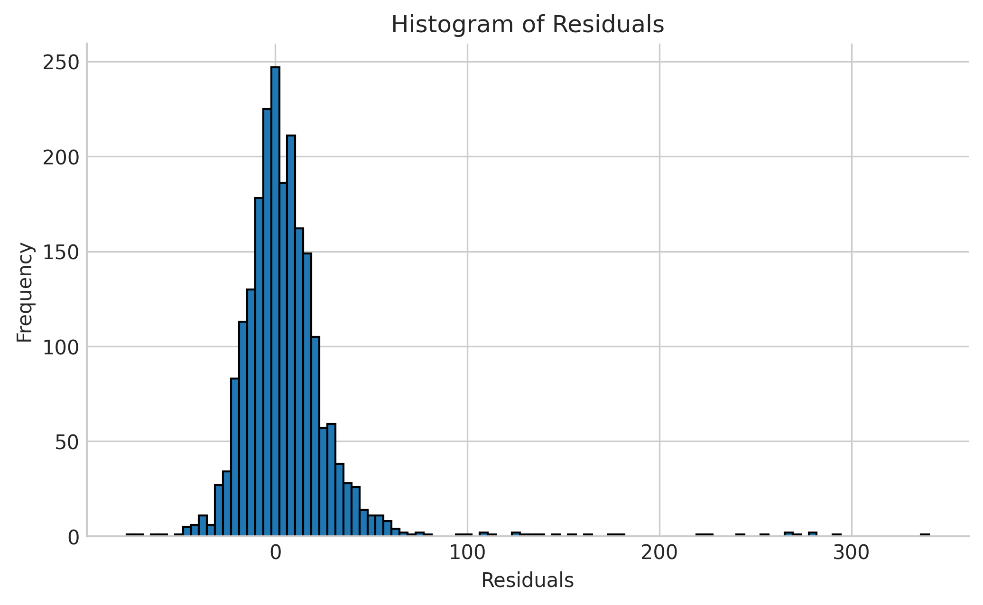
Speed over Outflow
Degree = 1
N-info-values = 21
xlag = 4
ylag = 4
estimator = least_squares
Degree = 2
N-info-values = 10
xlag = 4
ylag = 4
estimator = least_squares
MAE = 25.48
MSE = 1118.57
RMSE = 33.45
RRSE = 0.53
MAE = 15.89
MSE = 823.27
RMSE = 28.69
RRSE = 0.56
Notes:
Christian

Slide 14
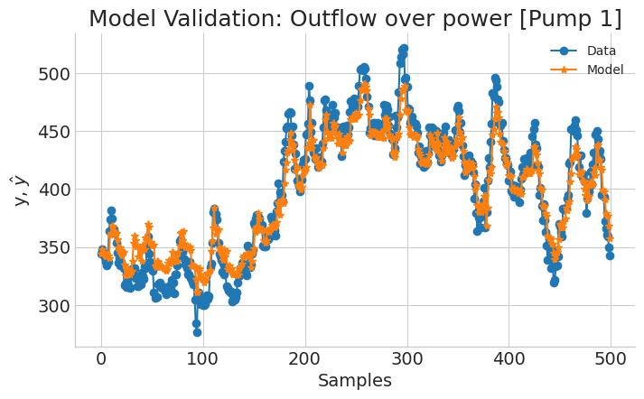
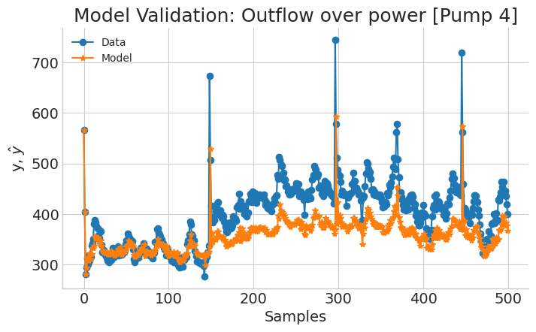
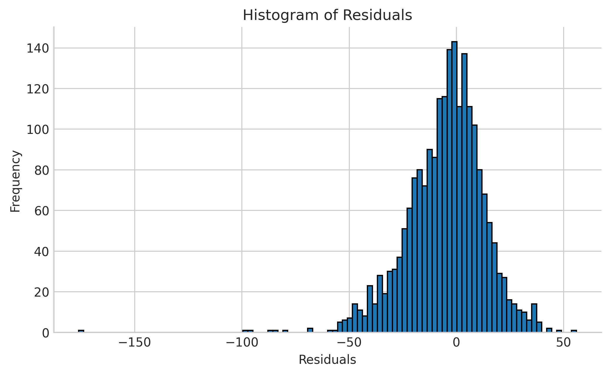
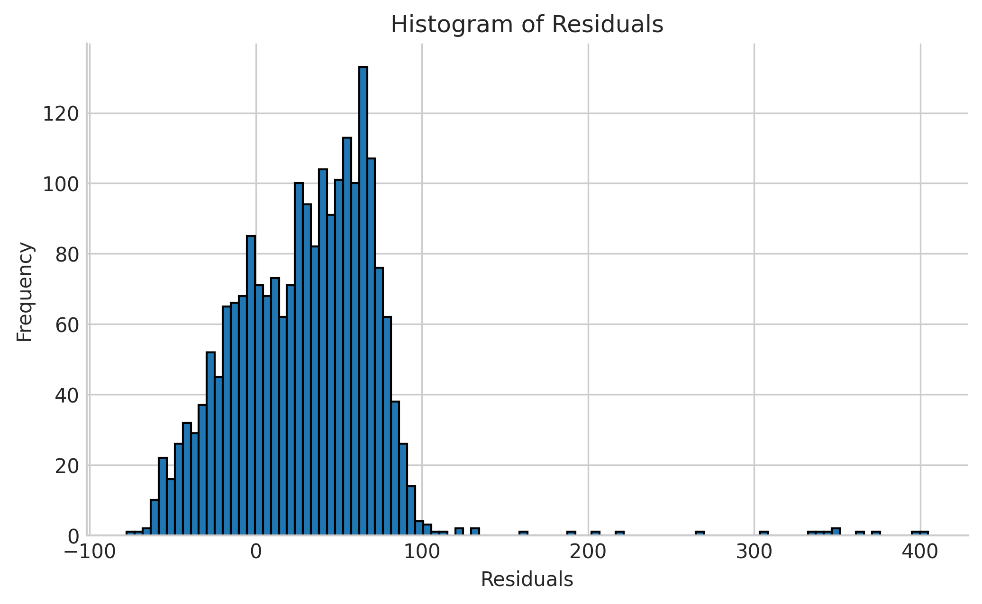
Outflow over power
Degree = 1
N-info-values = 16
xlag = 3
ylag = 3
estimator = least_squares
Degree = 1
N-info-values = 12
xlag = 5
ylag = 5
estimator = recursive_least_squares
MAE = 13.70
MSE = 342.54
RMSE = 18.51
RRSE = 0.31
MAE = 41.53
MSE = 2862.18
RMSE =53.50
RRSE = 0.79
Notes:
Christian

Slide 15

Kalman filter
Notes:
Emil

Slide 16

Kalman filter
To create a more advanced model We need more parameters
We can’t measure inflow, but we can estimate it with Kalman filter.
Notes:
Emil

Slide 17
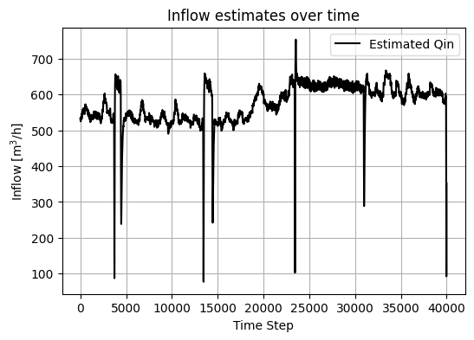
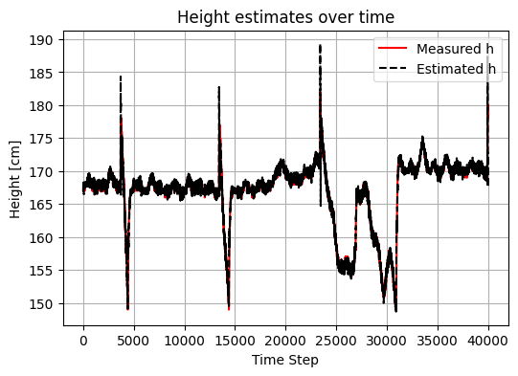
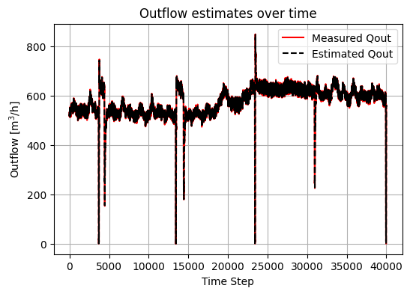
Inflow estimation
from filterpy.kalman import KalmanFilter
# Define the state transition matrix (A)
A = np.array([[1, 0, 0], [t/area, 1, -t/area], [0, 0, 1]])
# Create a Kalman Filter instance kf = KalmanFilter(dim_x=3, dim_z=2)
# Define the state transition (F) and observation (H) matrices
kf.F = A
kf.H = np.array([[0, 1, 0], [0, 0, 1]])
for index, row in df.iterrows():
kf.predict()
measurement = np.array([row['height'], row['outflow']])
kf.update(measurement)
estimates.append(kf.x.copy())
Notes:
Emil

Slide 18
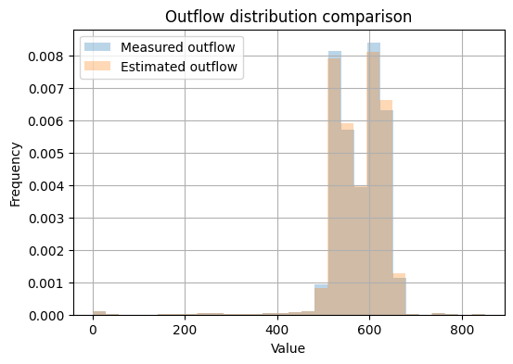
Measure of statistical distance between distributions – relative entropy
Kullback-Liebler Divergence
KL between measurement and estimation of outflow = 0.0012

Slide 19
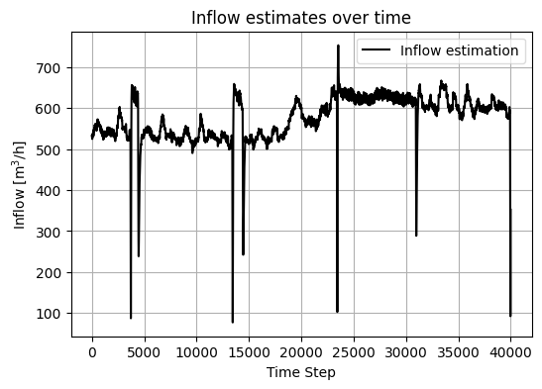
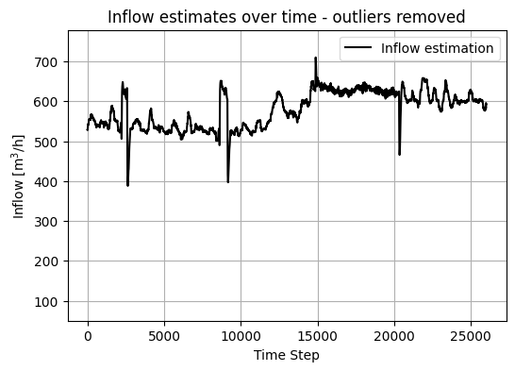
Outlier removal
Notes:
Emil

Slide 20

Inflow
Kalman

Slide 21

Neural Network
Notes:
Thomas

Slide 22
Neural Network
narx_net = NARXNN(
ylag=6,
xlag=6,
basis_function=basis_function,
model_type="NARMAX",
loss_func="mse_loss",
optimizer="Adam",
epochs=11,
learning_rate = 4e-3,
verbose=False,
optim_params={
"betas": (0.9, 0.999),
"eps": 1e-05,
},
)
class NARX(nn.Module):
def __init__(self):
super().__init__()
self.lin = nn.Linear(12, 100)
self.lin2 = nn.Linear(100,100)
self.lin3 = nn.Linear(100, 1)
self.tanh = nn.ReLU()
def forward(self, xb):
z = self.lin(xb)
z = self.tanh(z)
z = self.lin2(z)
z = self.tanh(z)
z = self.lin3(z)
return z
Notes:
Thomas

Slide 23
Neural Network
pump_station_data = pd.read_parquet("/home/”PATH”/pump_station_data.parquet")
pump_station_data_resampled = pump_station_data.resample("1T").mean()
pump_station_data_resampled_pump1on = pump_station_data_resampled[
(pump_station_data_resampled["pump1_rpm"] > 0) &
(pump_station_data_resampled["pump4_rpm"] == 0)]
scaler = StandardScaler()
scaled_data = scaler.fit_transform(pump_station_data_resampled_pump1on)
df_scaled = pd.DataFrame(
scaled_data,
columns=pump_station_data_resampled_pump1on.columns,
index=pump_station_data_resampled_pump1on.index
)
train = df_scaled.loc["2023-01-27":"2023-01-30"]
test = df_scaled.loc["2023-02-27":"2023-03-02"]
Notes:
Thomas

Slide 24
Neural Network
NN1:
FEATURES = "outflow"
TARGET = 'height’
NN2:
FEATURES = "pump1_rpm"
TARGET = 'outflow’
x_train, y_train = train[FEATURES].values.reshape(-1,1), train[TARGET].values.reshape(-1,1)
x_test, y_test= test[FEATURES].values.reshape(-1,1), test[TARGET].values.reshape(-1,1)
Notes:
Thomas

Slide 25
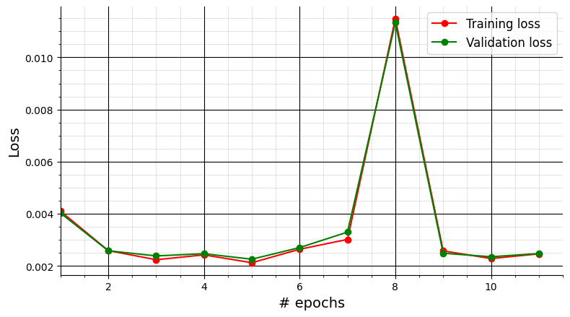
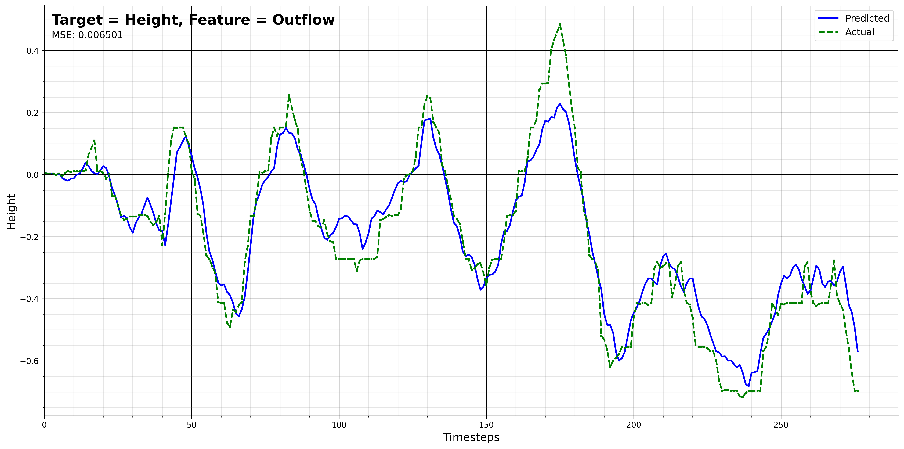
NN1
NN1:
FEATURES = "outflow"
TARGET = 'height’
Notes:
Thomas

Slide 26
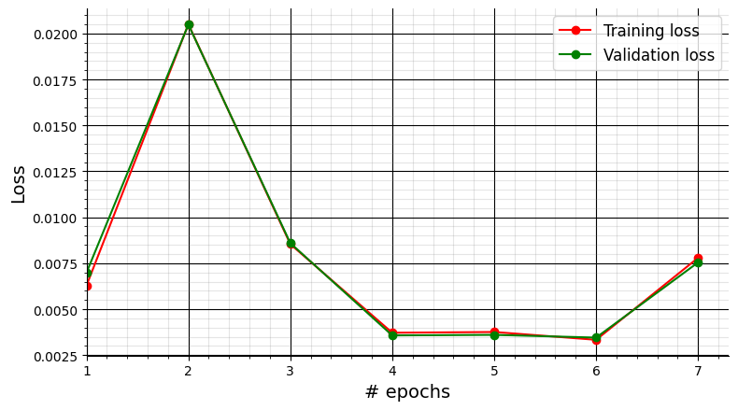
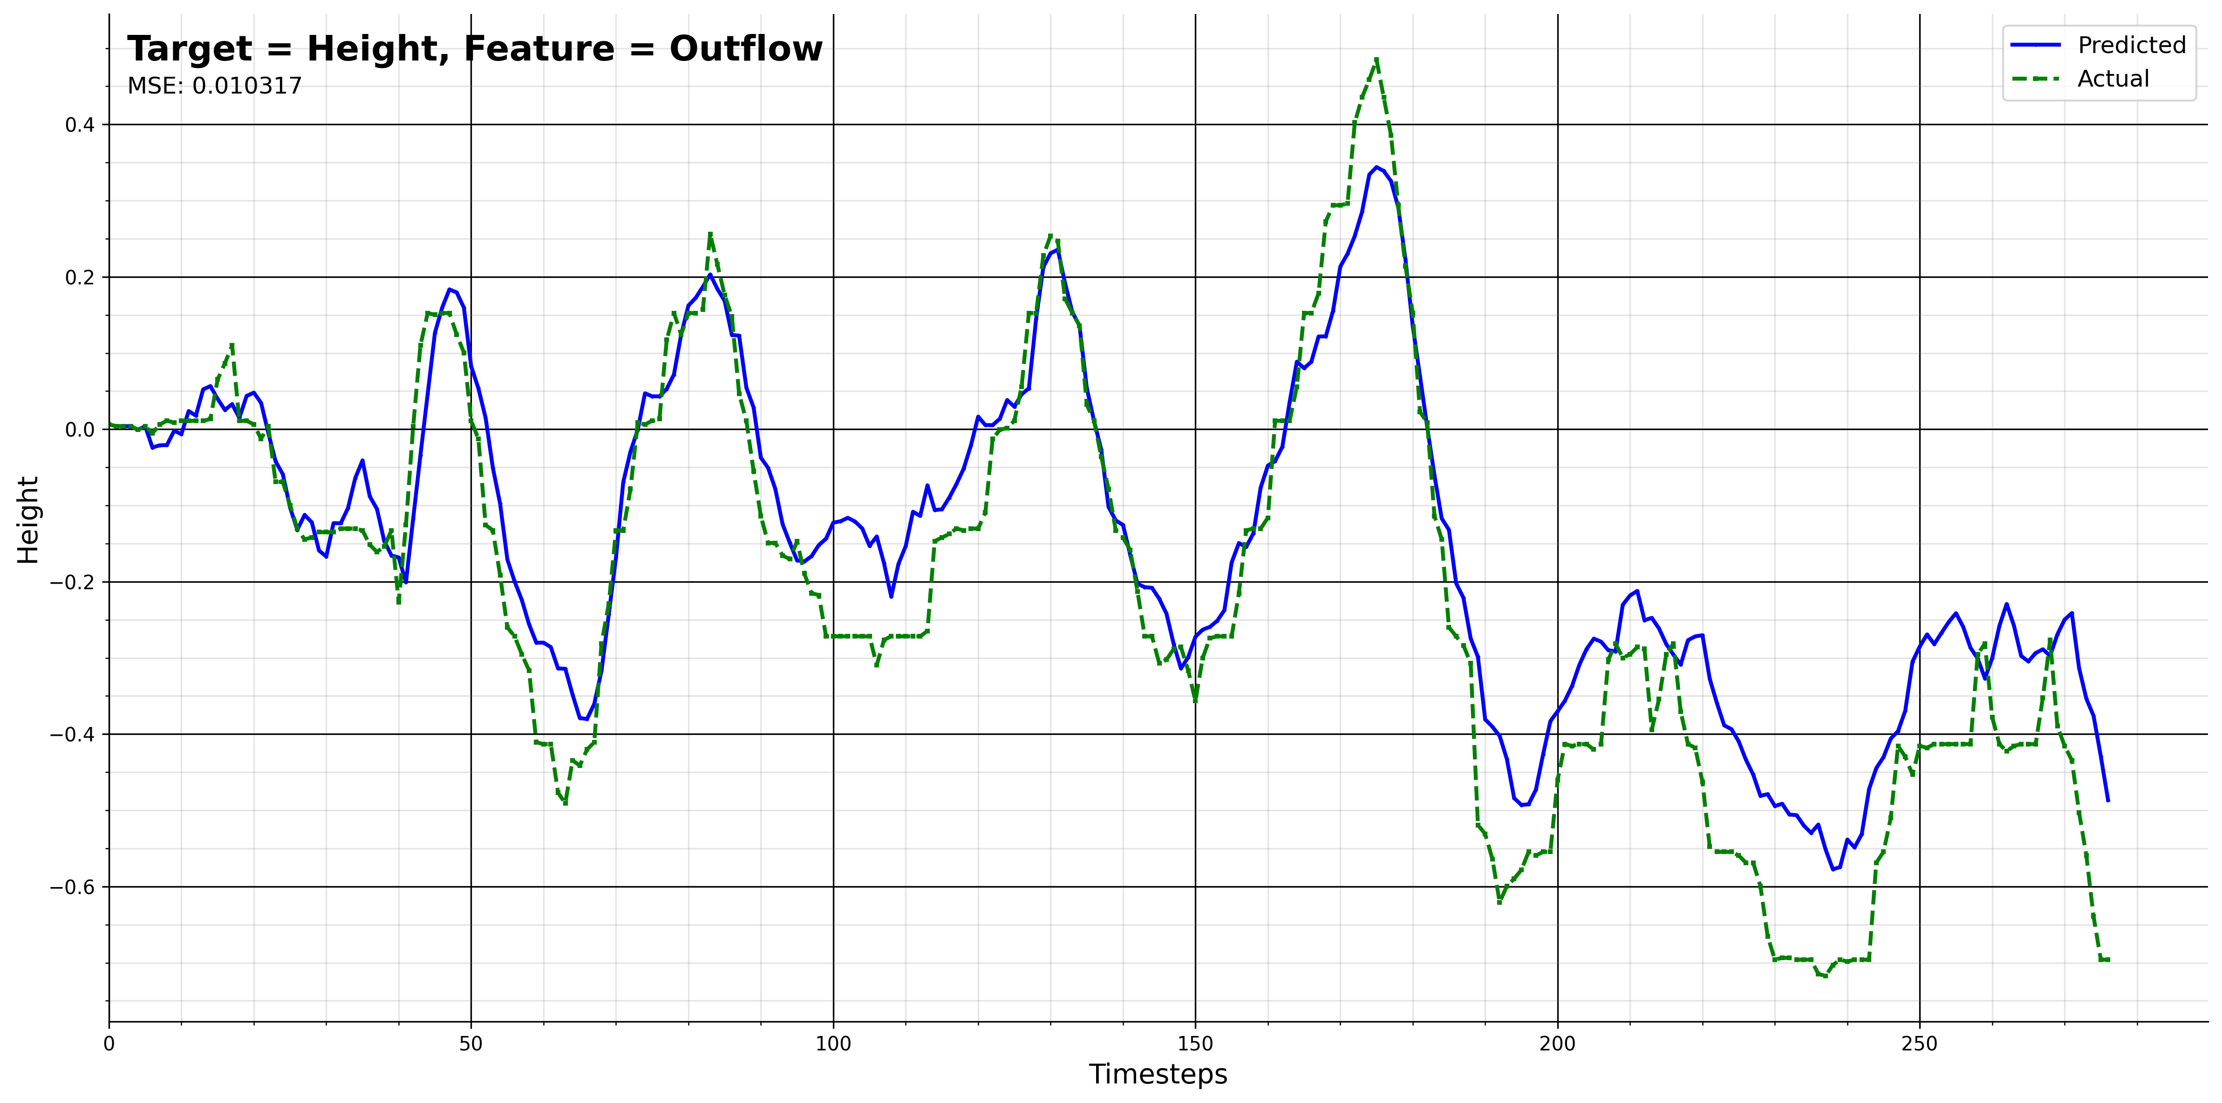
NN1
NN1:
FEATURES = "outflow"
TARGET = 'height’
Notes:
Thomas

Slide 27
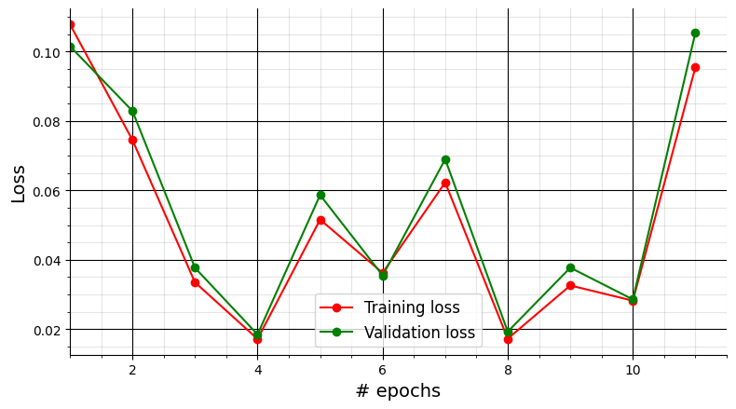
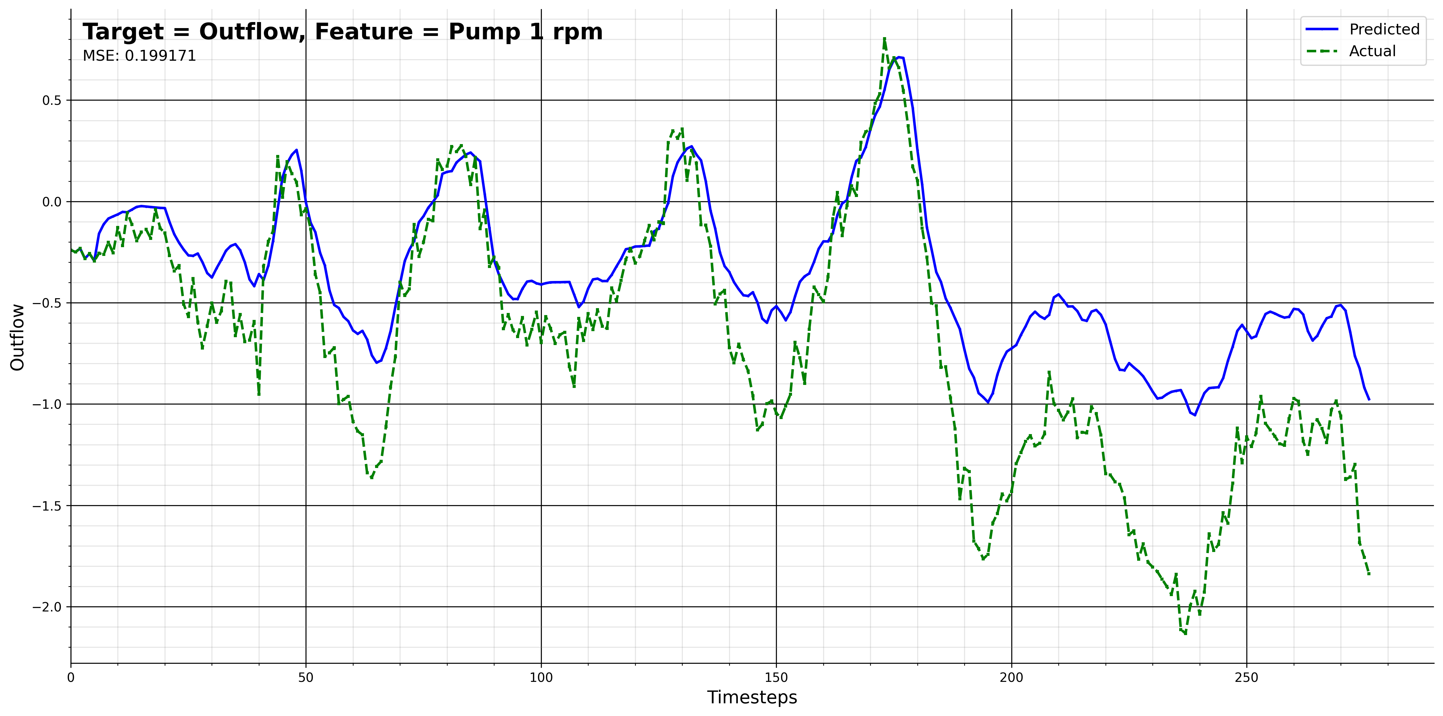
NN2
NN2:
FEATURES = "pump1_rpm"
TARGET = 'outflow’
Notes:
Thomas

Slide 28
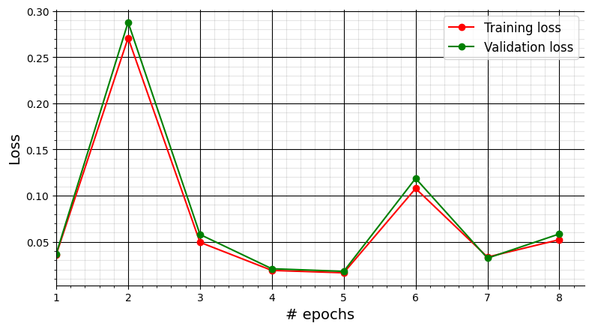
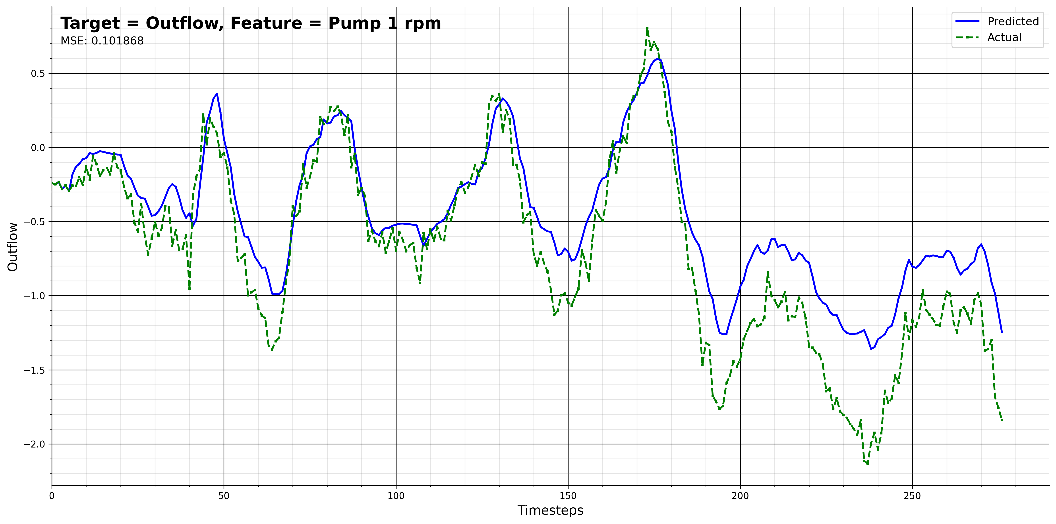
NN2
NN2:
FEATURES = "pump1_rpm"
TARGET = 'outflow’
Notes:
Thomas

Slide 29
Inflow Data
NN3:
inflow_data = pd.read_csv("/home/”PATH”/InflowData.csv")
inflow_data = inflow_data["0"]
pump_station_data = pd.read_parquet("/home/”PATH”/pump_station_data.parquet")
pump_station_data.insert(2, "inflow", inflow_data.values, True)
pump_station_data_w_inflow_resampled = pump_station_data.resample("1T").mean()
…
Normalization
…
FEATURES = "inflow"
TARGET = 'outflow'
x_train, y_train = train[FEATURES].values.reshape(-1,1), train[TARGET].values.reshape(-1,1)
x_test, y_test= test[FEATURES].values.reshape(-1,1), test[TARGET].values.reshape(-1,1)
Notes:
Thomas

Slide 30
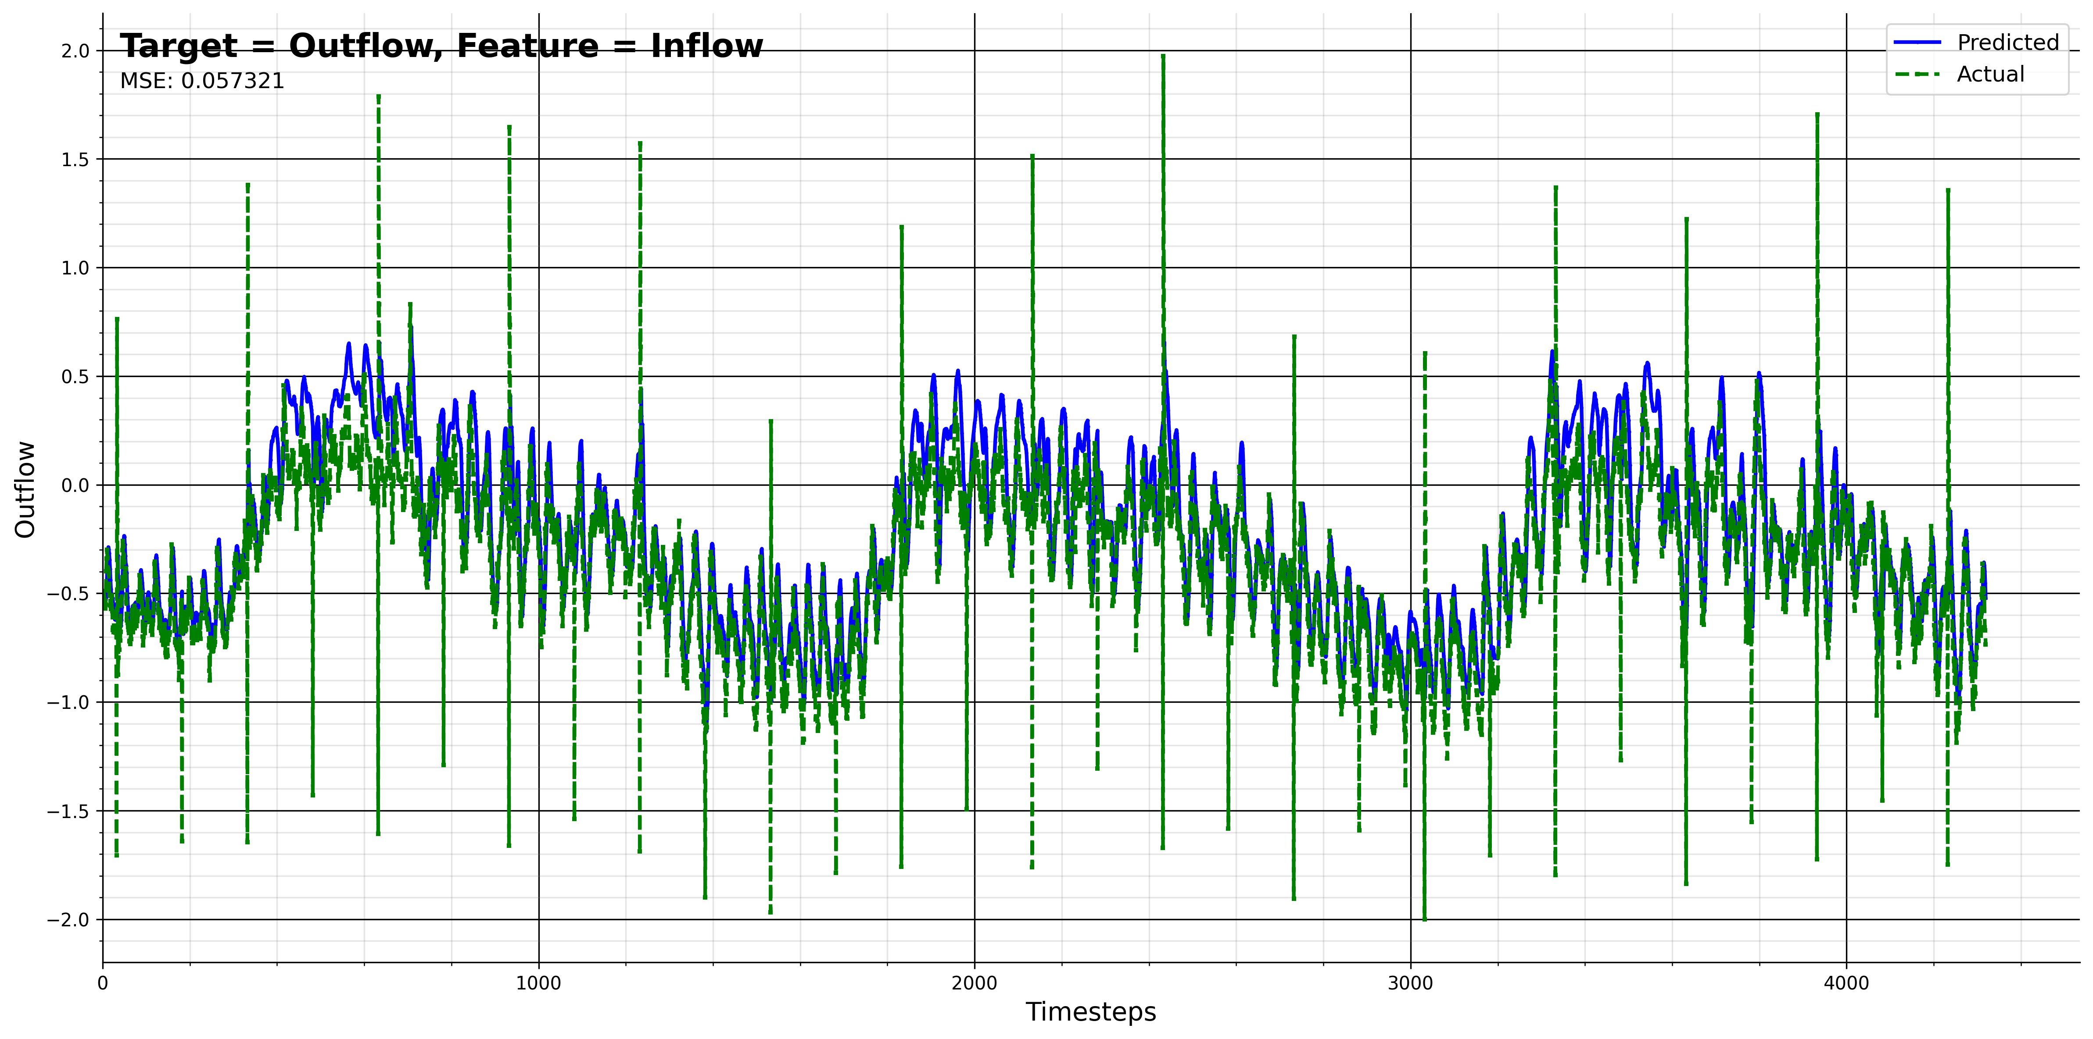
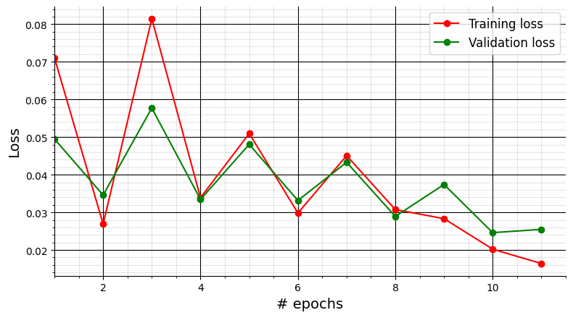
NN3
Notes:
Thomas

Slide 31
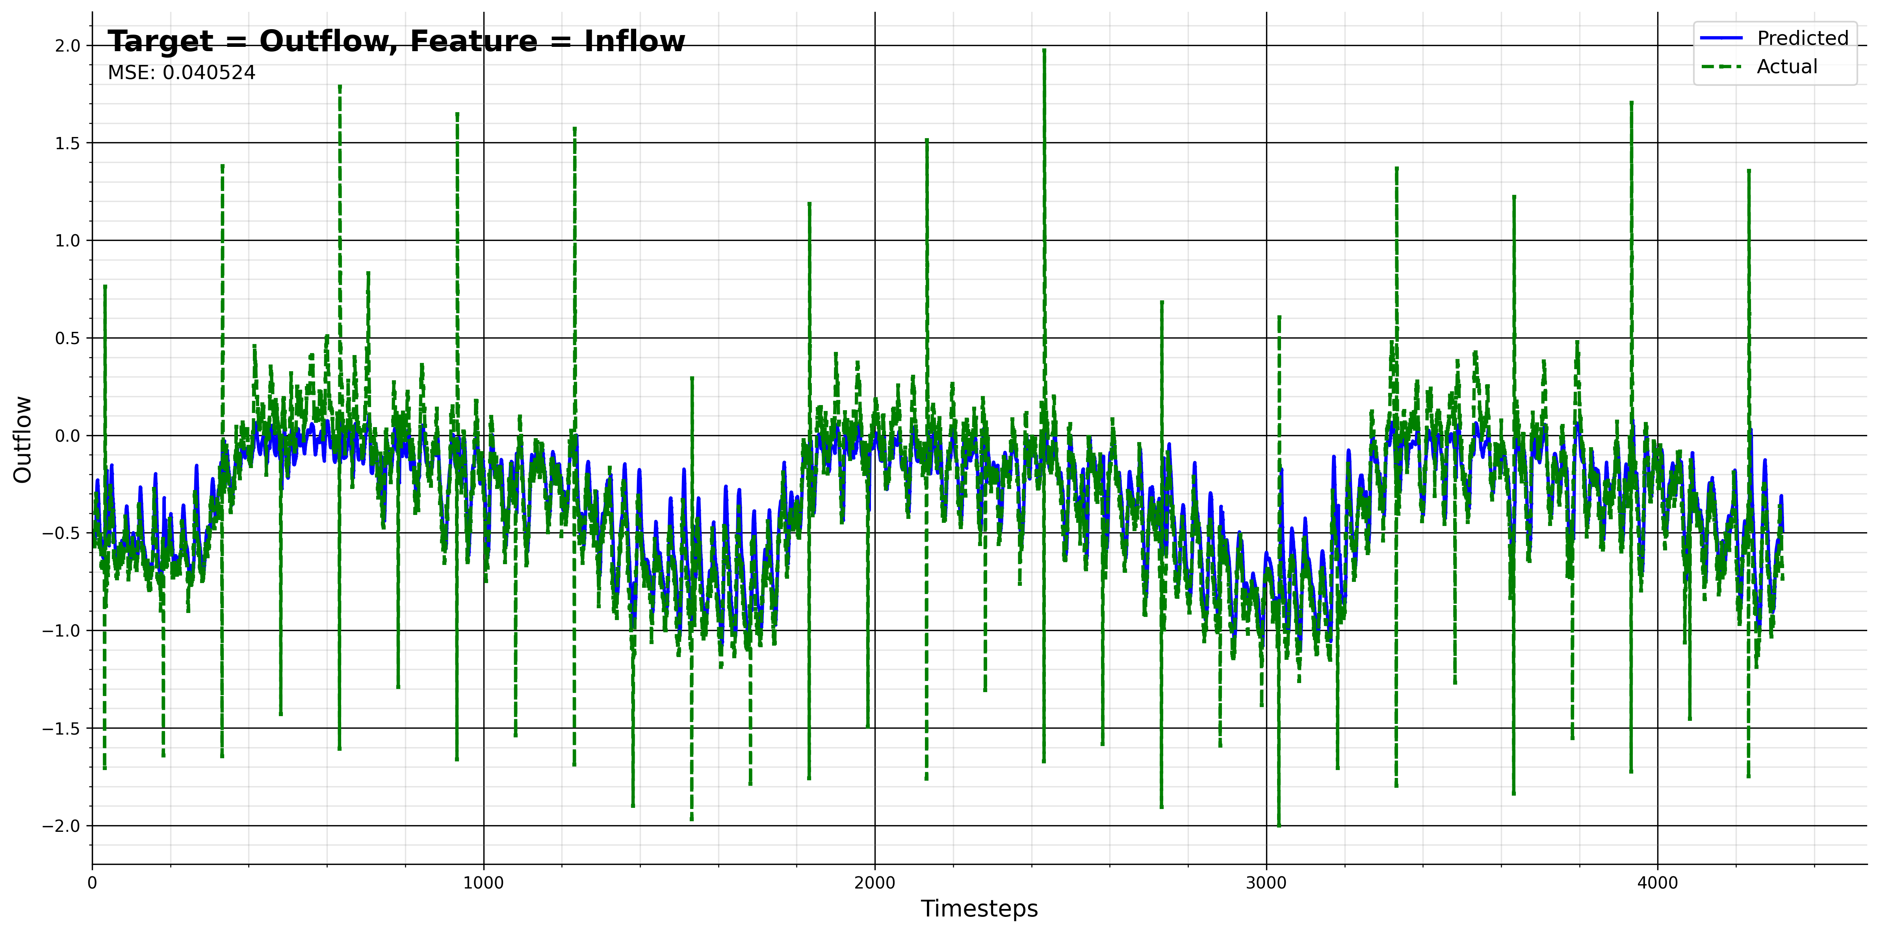
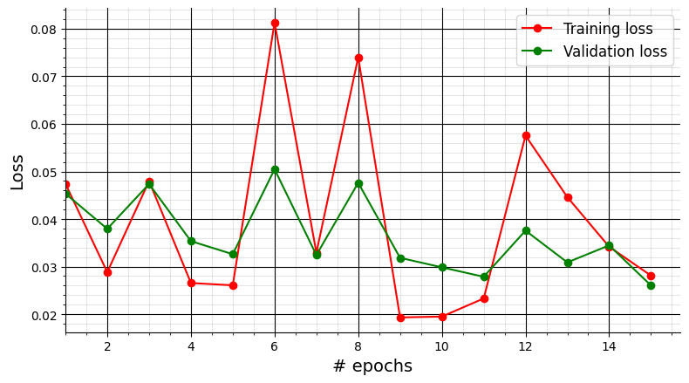
NN3
Notes:
Thomas

Slide 32

The best model for
 | Static Model | Dynamic Model | Neural Network
Model | Power over Speed [Pump 1] | Power over Speed [Pump 1] | Height over Outflow [Pump 1]
Mean Absolute Error | 0.95 | 1.1952
Mean Square Error | 1.38 | 2.4745 | 0.006501
Root Mean Square Error | 1.17 | 1.5731
Root Relative Square Error | 0.26 | 0.3695
Notes:
Westmann

Slide 33

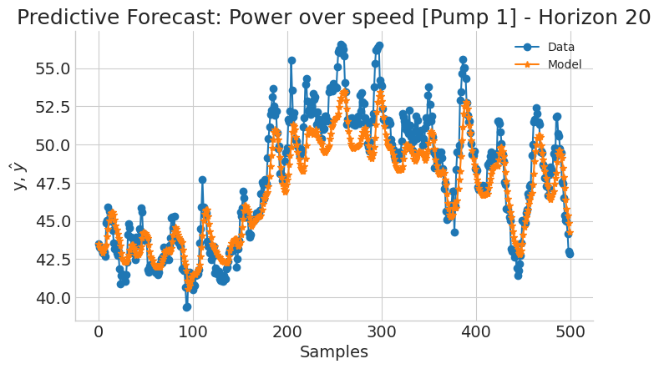
Forecasting on different horizons
Notes:
Westmann

Slide 34
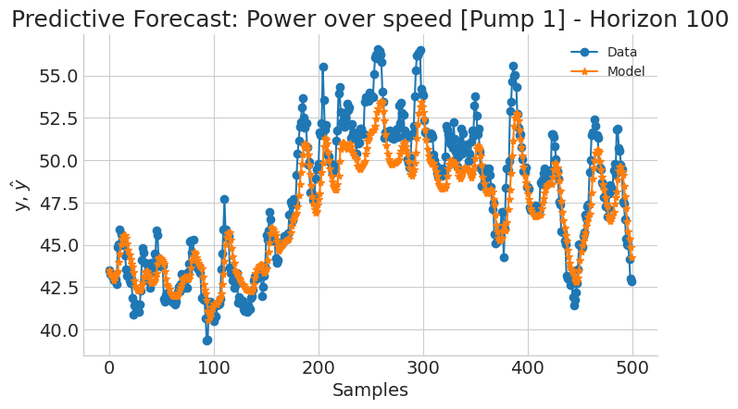
Forecasting on different horizons
Notes:
Westmann

Slide 35

Forecasting on different horizons
Notes:
Westmann

Slide 36

Thank you for your time! Questions?

Slide 37
Inflow
Kalman

Slide 38

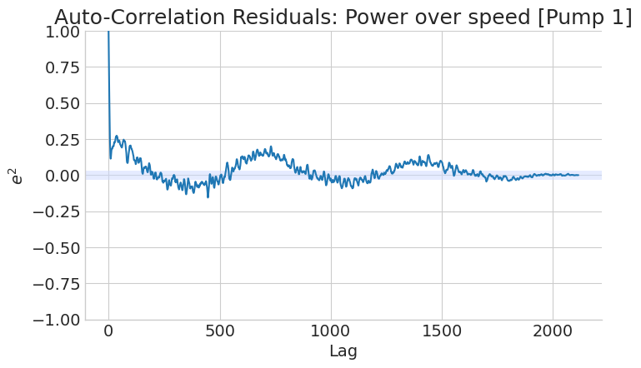
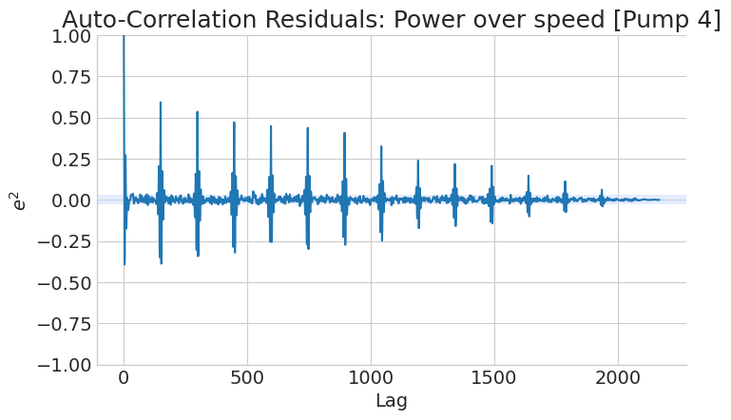
Power over speed

Slide 39
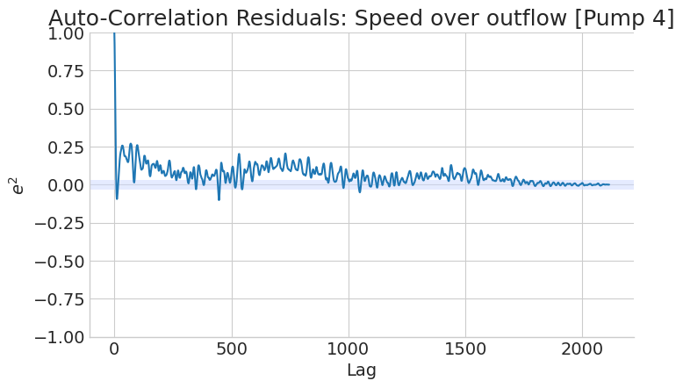
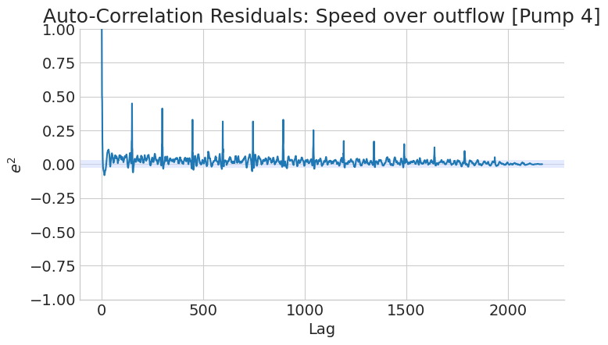
Speed over Outflow

Slide 40
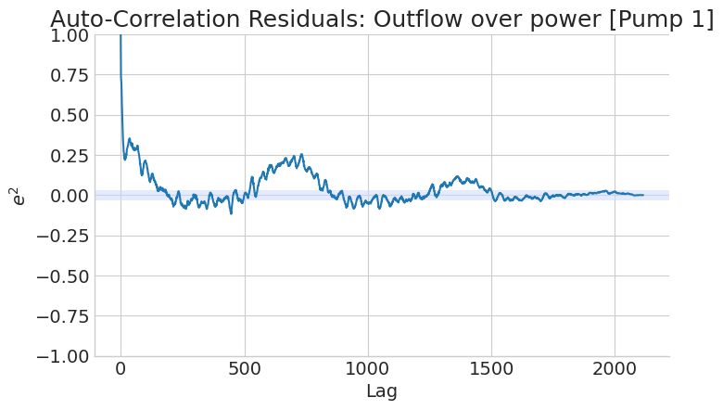
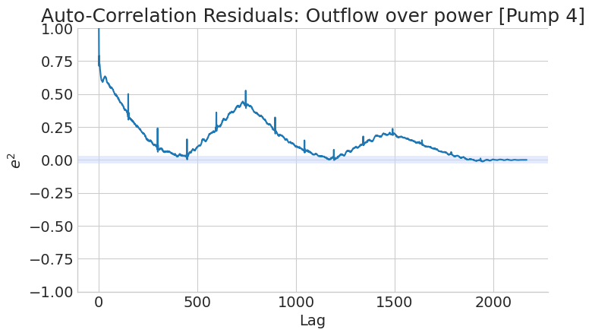
Outflow over power

Slide 41
All the errors
Static Model | Mean Absolute Error | Mean Square Error | Root Mean Square Error | Root Relative Square Error
Power&Speed Pump1 | 0.95 | 1.38 | 1.17 | 0.26
Power&Speed Pump4 | 0.72 | 0.82 | 0.91 | 0.23
Speed&Outflow Pump1 | 8.60 | 128.58 | 11.34 | 0.19
Speed&Outflow Pump4 | 11.90 | 260.89 | 16.15 | 0.23
Outflow&Power Pump1 | 15.25 | 370.42 | 19.25 | 0.32
Outflow&Power Pump4 | 18.44 | 546.54 | 23.38 | 0.34
Dynamic Model | Mean Absolute Error | Mean Square Error | Root Mean Square Error | Root Relative Square Error
Power&Speed Pump1 | 1.20 | 1.57 | 2.47 | 0.37
Power&Speed Pump4 | 1.64 | 3.04 | 9.23 | 0.82
Speed&Outflow Pump1 | 25.48 | 1118.57 | 33.45 | 0.53
Speed&Outflow Pump4 | 15.89 | 823.27 | 28.69 | 0.56
Outflow&Power Pump1 | 13.70 | 342.54 | 18.51 | 0.31
Outflow&Power Pump4 | 41.53 | 2862.18 | 53.50 | 0.79
Neural Network | Mean Square Error
Height&Outflow | 0.006501
Height&Speed Pump1 | 0.199171
Outflow&Inflow | 0.040524

